Slide 1
Topic 1.1 – Periodic table patterns
Unit 1

Slide 2
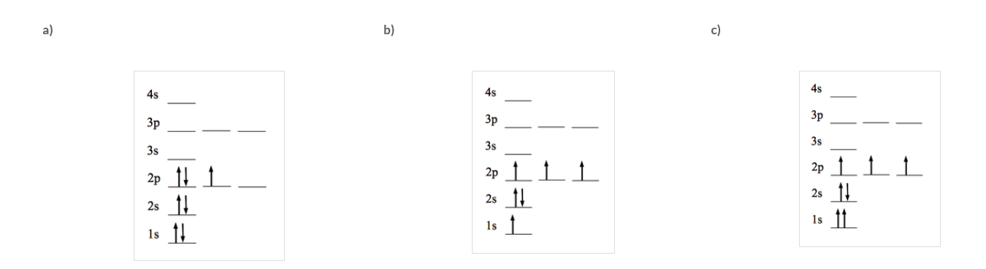
1. ¹⁴N makes up 99.6% of a sample; the remainder is ¹⁵N. Calculate the average atomic mass of Nitrogen.
14.004 units
2. List the electron configuration of , using spdf notation. Use this to draw a diagram illustrating the electron configuration.
P = 1s2, 2s2, 2p6, 3s2, 3p3
Or [Ne], 3s2, 3p3
3. State the rule broken by the
three electron configurations
diagrams (right).
Redraw the correct electron
configuration for this atom.
Notes:
(14x0.996)+(15x0.004)=14.004
P = 1s2, 2s2, 2p6, 3s2, 3p3 or [Ne], 3s2, 3p3
A. Hund’s Rule, B. Aufbau, C. Pauli Exclusion
1s2, 2s2, 2p3

Slide 3
Vocab List
Noble gas
Halogens
Alkali metal
Element
Transition Metal
Reactivity
Metallic
Non-metallic
Group
Period
Atomic Radii
Ionisation
Valency
Electronegativity

Slide 4
Learning goal
State that elements are represented by symbols.
Identify that the structure of the periodic table based on increasing atomic number.
Identify that the periodic table is arranged into four blocks associated with the four sub-levels — s, p, d and f.
Describe the relationship between the structure of the periodic table and the electronic configuration of atoms.
Explain that elements of the periodic table show trends in chemical and physical properties across periods and down groups as exemplified by groups 1, 2, 13–18 and period 3.
Compare the metallic and non-metallic behaviours of elements, including group trends and the reactivity for the alkali metals (Li–Cs) and the halogens (F–I).
Identify that oxides change from basic through amphoteric to acidic across period 3.
Analyse data for atomic radii, valencies, ionic radii, 1st ionisation energy and electronegativities to determine periodic trends, patterns and relationships.

Slide 5

History of the periodic table
Notes:
https://www.youtube.com/watch?v=0RRVV4Diomg – crash course
https://www.youtube.com/watch?v=fPnwBITSmgU – ted ed

Slide 6
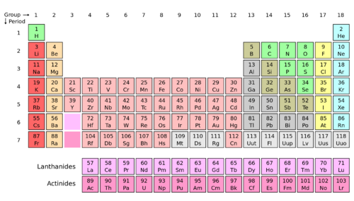
Periodic table organisation
Organised into:
7 Periods:
Rows. A new period begins when a new principal energy level begins filling with electrons.
18 Groups:
Columns based on the organization of outer shell electrons
Based on increasing atomic number. Also listed is each element’s symbol, name and atomic mass.

Slide 7
groups
Includes:
Metals – Groups 1, 2 and 3-12
Alkali Metals
Alkali Earth Metals
Transition Metals
Non Metals – Groups 17, 18
Halogens
Noble Gases
Others – Groups 13-16
Some are metals, some are not, some are Metalloids (have some characteristics of a metal)
Boron Group
Carbon Group
Nitrogen Group
Oxygen Group

Slide 8
Layout of the Periodic Table
General Properties
Metals:
Good conductors of electricity and heat.
Shiny.
High melting points.
Non-metals:
Poor conductors of electricity and heat.
Dull.
Low melting points.
Metals
Nonmetals

Slide 9
More specifically….
Noble Gases
Inert (low reactivity).
Odorless
Colourless
The ‘influencers’ of the atomic world… but more on this later.
Alkali metals
Very reactive.
Soft metals.
Low melting points.
Transition metals
High melting points (exception is mercury).
Good conductors of heat and electricity.
Hard metals.
Halogens
Highly reactive, especially with alkali metals.
Low melting and boiling points.
Alkali earth metals
Highly reactive.
Good conductors of electricity.
Grey-white lustre.
Metalloids
Similar physical appearance to metals.
Brittle.
Semi-conductors of electricity.

Slide 10
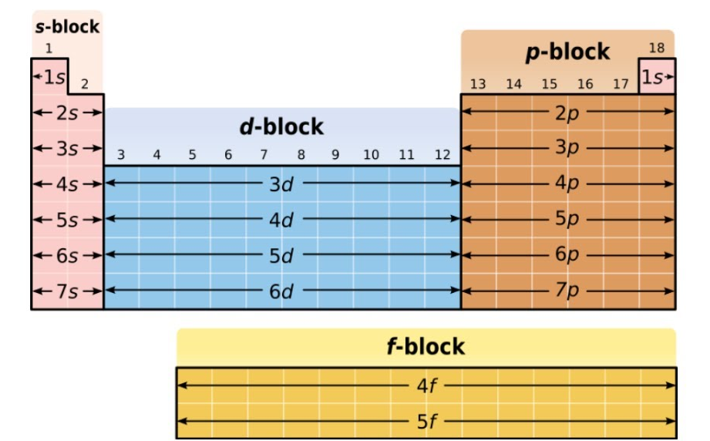
The periodic table and electron configurations

Slide 11
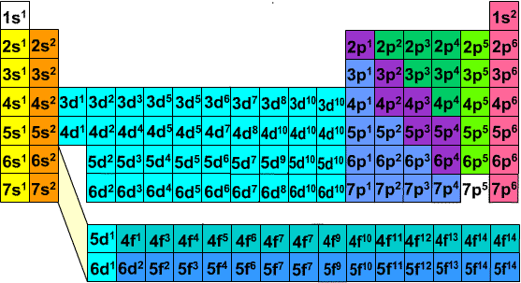
The periodic table and electron configurations

Slide 12
Periodicity – study of patterns in periodic table
Periodic table shows a number of trends across periods and down groups; including:
Atomic Radius
Valency
Electronegativity
Ionic Radius
Melting point
First Ionisation energy
Notes:
https://chem.libretexts.org/Bookshelves/Inorganic_Chemistry/Supplemental_Modules_(Inorganic_Chemistry)/Descriptive_Chemistry/Periodic_Trends_of_Elemental_Properties/Periodic_Trends
Note that atomic radii and electronegativity are inverse – this makes sense gives that as the number of electrons increase, atoms get more electro-negative, but too many protons will reduce this electronegativity. Similarly, having (relatively) more electrons will force them to be further away (as they fill more orbitals), increasing the radii. Having lots of protons however reduces this somewhat, as the nucleus will have more attractive force to said electrons.
Ionisation energy follows the same trend as electronegativity (more energy is required to ioinise the electrons that are closer to the nucleus i.e. s orbitals)
https://www.compoundchem.com/2014/02/12/periodicity-trends-in-the-periodic-table/
Valency is consistent across groups (we are only concerned about valence electrons in the unfilled orbitals).

Slide 13
Organised by atomic number
Increasing atomic number
Increasing atomic number

Slide 14
Atomic radius trends
Increasing atomic radius
Increasing atomic radius

Slide 15
ionic radius trends
Increasing ionic radius
Increasing ionic radius

Slide 16
number of valence electrons
Number of valence electrons:
1
2
3
4
5
6
7
8
Increasing number of valence electrons

Slide 17
ionisation energy trends
Increasing ionisation energy*
*amount of energy needed to remove one electron

Slide 18
Electronegativity trends
Increasing electronegativity
Increasing electronegativity

Slide 19
Successive ionisation energies
We know that:
First ionisation energy is the amount of energy needed to completely remove an electron from a neutral atom when it is a gas. A low ionisation energy = ion is formed very easily.
i.e. A A⁺
Successive ionisation energies are the amount of energy required to keep removing electrons from an atom. This can be used to determine electron configuration.
i.e. A⁺ A⁺² A⁺³
Notes:
Decreases down a group, as electrons in outer shells are further away from the nucleus
Increases left to right across a period

Slide 20
Successive ionisation energies
Successive ionisation energies are always increasing, as the more electrons are removed, the higher the attraction of the atom to the electrons that remain, therefore more energy is needed to remove the next electron.
There is always a significant jump in energy needed to remove electrons from the next shell

Slide 21
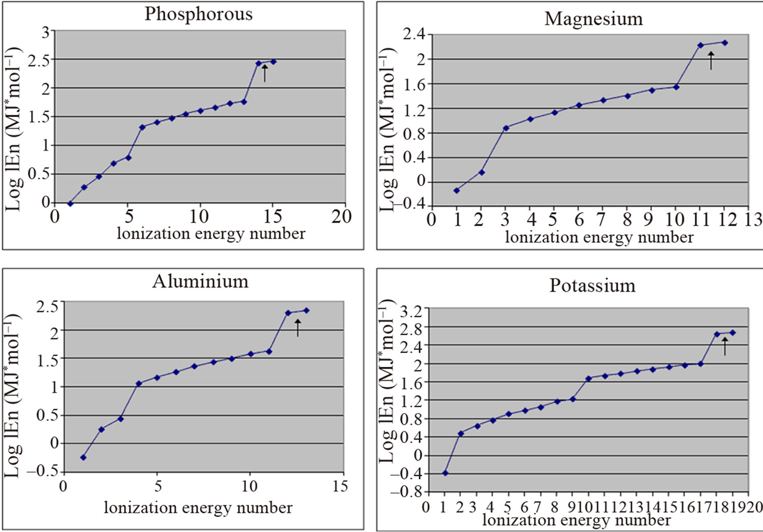
Notes:
These graphs show the energy required to remove electrons from each of these atoms. Note the large jumps as each new energy level (1, 2, 3) is “cracked”.

Slide 22
Your turn
In a small group (2 – 4), choose a trend and research to:
Describe the chemical property that you are researching.
Describe how the trend is seen across periods and down groups.
Explain why that specific trend occurs
Find some data that supports your trend description (HINT: Use groups 1, 2, 13–18 and up to period 3 for your data)
You can complete this in the collaborative space on OneNote, so all members of the group are working at the same time

Slide 23
Professor dave explains trends
Notes:
https://www.youtube.com/watch?v=hePb00CqvP0

Slide 24
Familiarisation with groupings
Complete the Interactive: the Periodic Table, to play ‘Which One of These Elements Doesn’t Belong?”
http://www.learner.org/interactives/periodic/belong/

Slide 25
Test your skills
http://www.learner.org/interactives/periodic/testskills/

Slide 26
homework
Define the term oxide.
Describe how the behaviour of oxides (in terms of reacting with water) change across period 3. (Hint: use words like acidic, basic and amphoteric in your description).

Slide 27
homework
http://www.learner.org/interactives/periodic/groups.html
An interactive Periodic Table that might help…
Choose one periodic table group to research, answering the following:
List the atoms in your group
Identify the electron sub-level filled by this group
Explain their chemical and physical properties
Compare and explain Metallic and non-metallic behaviours within that group (Hint: are some metals? Are all metals? Are some hard to classify?
Comment on the reactivity of the group (esp alkali metals and halogens)
You can complete this in the collaborative space on OneNote, so all members of the group are working at the same time

